Slide 1

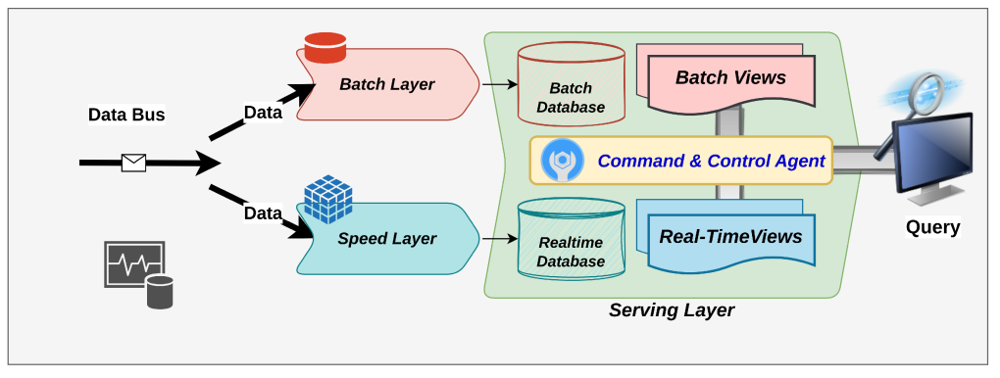
Lab 05 - Lambda Architecture
https://bit.ly/4qq3wqa

